Slide 1
Semantic Search in articles

Slide 2
Data Set
Medium is a prominent platform for disseminating knowledge across a wide range of topics. It is particularly renowned for articles on Machine Learning, Artificial Intelligence, and Data Science. This dataset comprises a collection of approximately 350 articles within these domains.
The dataset originally contains a total of 192,368 articles. For the purpose of testing the pipeline, a subset of 200 articles was selected. These 200 articles were further split into sentences, from which 400 sentences were chosen to create pairs for training a sentence transformer.
The statistics for the pairs created are as follows:
Training Set: 64,160 pairs
Validation Set: 14,436 pairs
Testing Set: 1604 pairs

Slide 3
Data Set
To assess the similarity between pairs, the dataset utilizes Term Frequency-Inverse Document Frequency (TF-IDF) and cosine similarity matrices. These measures help in evaluating and refining the quality of the sentence pairs for the sentence transformer model.

Slide 4
Preprocessing
Tokenization: The text is split into individual tokens or words.
Lowercasing: All text is converted to lowercase to ensure uniformity.
Removal of Stop Words: Common, non-informative words are removed.
Punctuation Removal: Punctuation marks are eliminated to focus on meaningful words.

Slide 5
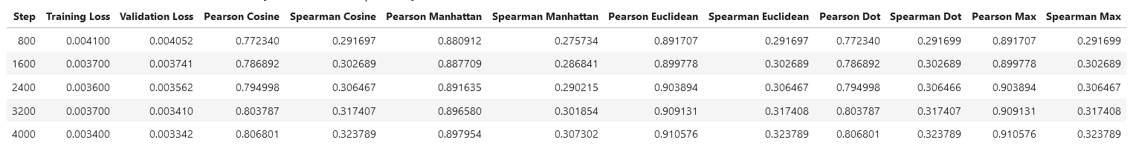
Fine Tune Sentence Transformer
The all-MiniLM-L6-v2 model This is a sentence-transformers model: It maps sentences & paragraphs to a 768 dimensional dense vector space and can be used for tasks like clustering or semantic search
Loss Cosine Similarity Loss for pairs.
Training Results:

Slide 6
Fine Tune Sentence Transformer
Testing Results:
Pearson Correlation Coefficient:
Cosine Similarity: 0.767
Manhattan Distance: 0.878
Euclidean Distance: 0.895
Dot Product: 0.767
Max Similarity: 0.895
Spearman Rank Correlation Coefficient:
Cosine Similarity: 0.335
Manhattan Distance: 0.330
Euclidean Distance: 0.335
Dot Product: 0.335
Max Similarity: 0.335

Slide 7
FAISS Vector Database
Embedding Generation: A vector database is created for the article texts using the FAISS library and the all-mpnet-base-v2 model from the Sentence Transformers library. This involves generating embeddings for each article using the Hugging Face API.

Slide 8
Search
Query Embedding: An embedding is generated for the search query (key).
Article Matching: The most relevant articles are identified by finding the top N matches based on cosine similarity within the FAISS database.
Generate N-Hot Keywords:
Keyword Extraction: From the most relevant articles, a TF-IDF/Count Vectorizer is used to extract the top N hot keywords.
Visualization:
Word Cloud: A visual representation of the N-hot keywords is created using a word cloud to highlight the most significant terms.

Slide 9
Results
Search Query: "machine learning"
Top Matched Article:
"A machine learning method uncovered a hidden clue in people’s language predictive of the later manifestation of psychosis: the frequent use of words associated with sound. A paper published by the journal npj Schizophrenia released the findings by scientists from Emory University and Harvard University. Hidden details The researchers developed a new machine-learning methodology to more precisely quantify the semantic richness of people’s conversational language (a known indicator for psychosis). Their results indicated that automated analysis of the two language variables (more frequent use of words associated with sound and speaking with low semantic density, or vagueness) can predict if an at-risk person will later develop psychosis with an impressive 93 percent accuracy."

Slide 10
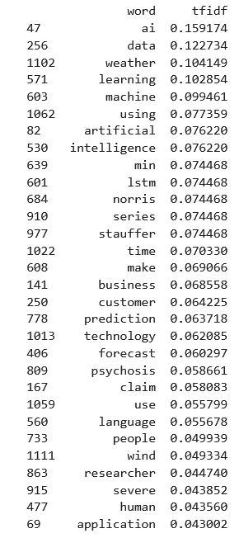
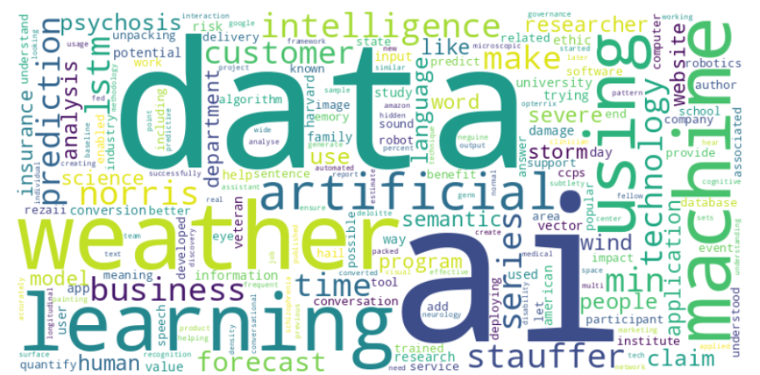
Results
TF-IDF Top matched words in N-Articles:

Slide 11
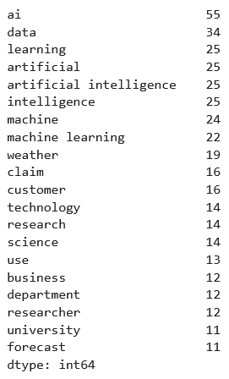
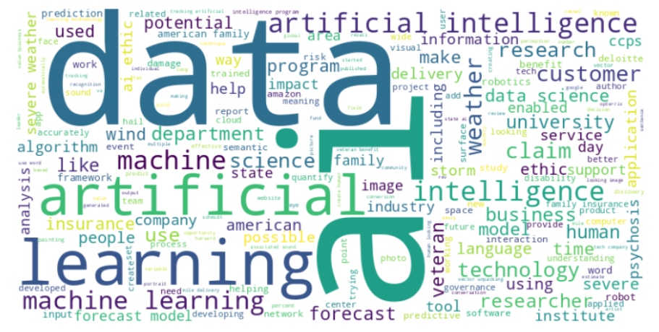
Results
Count Vectorizer Top matched words in N-Articles:

